Slide 1

Demo Video
Datathon 2025: Lifeline
TM 50.
Hou Junning & Tian Sijia & Fang Mingzhi

Slide 2
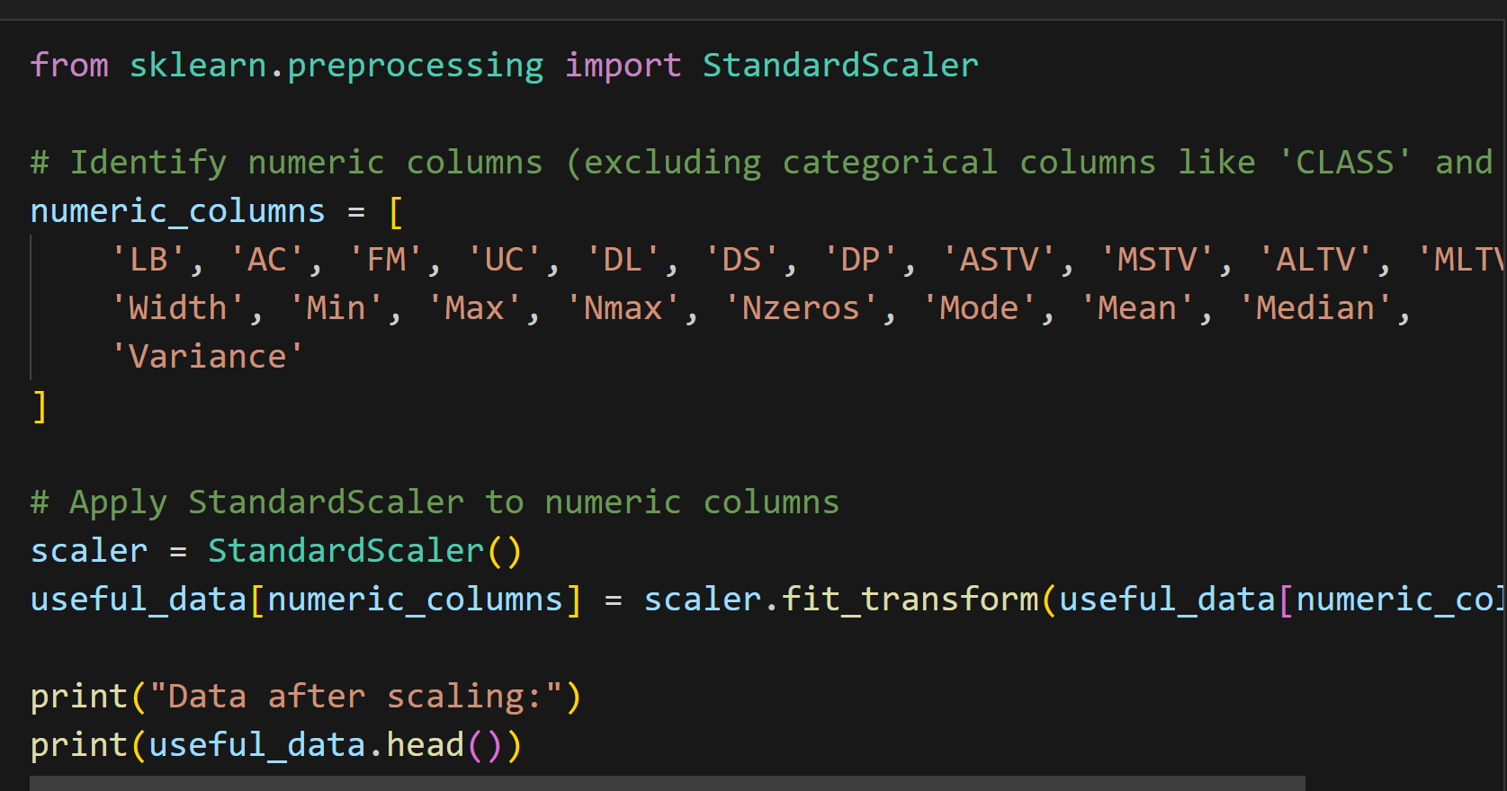
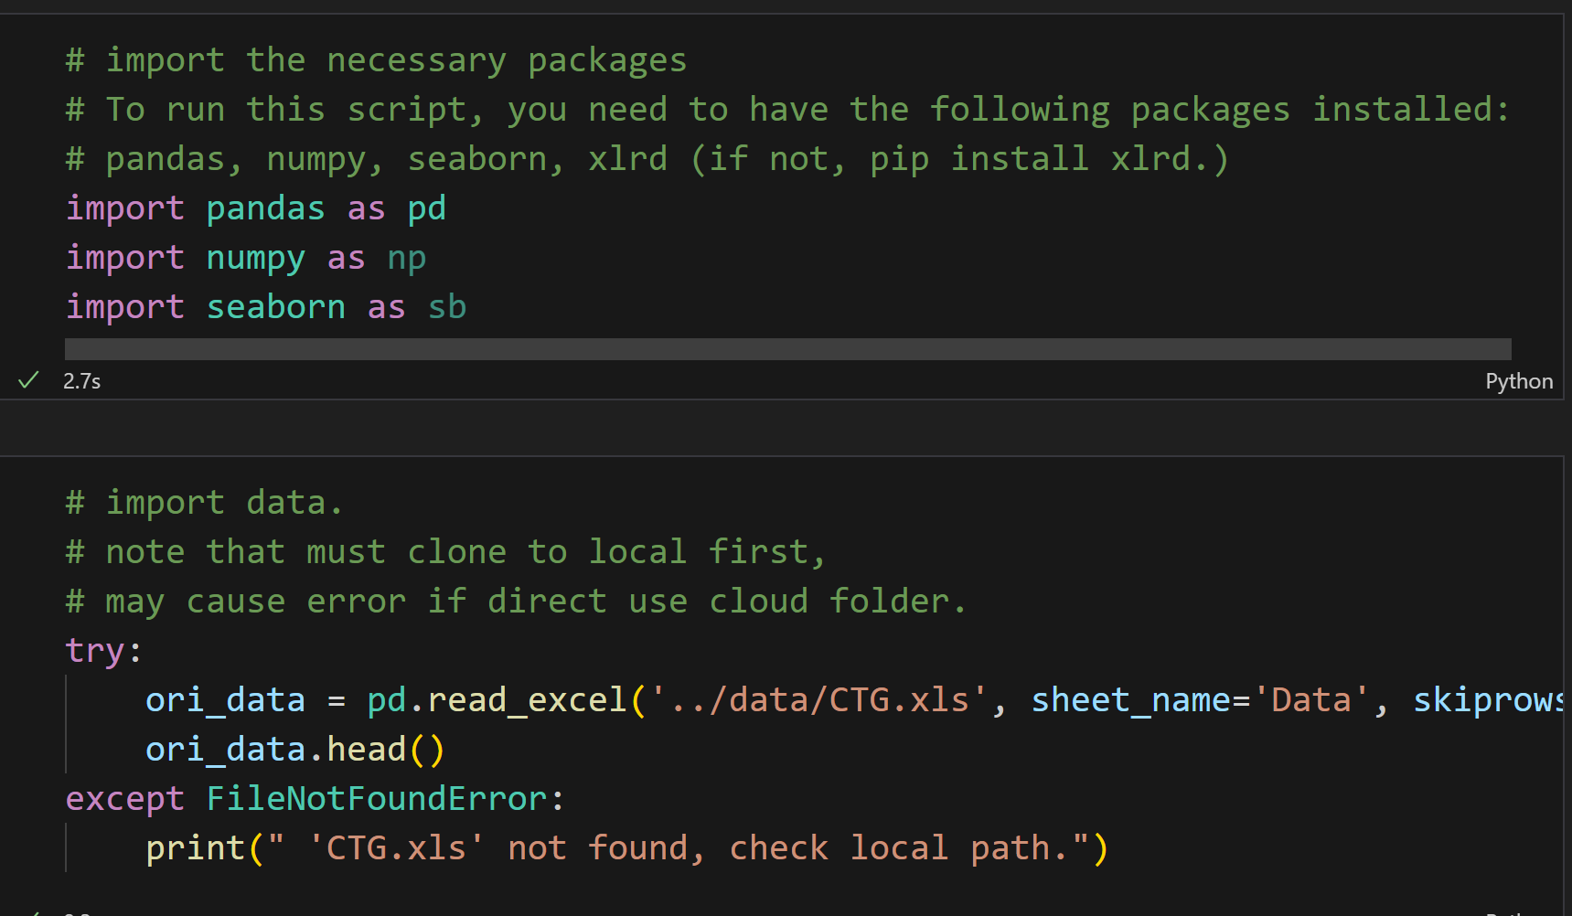
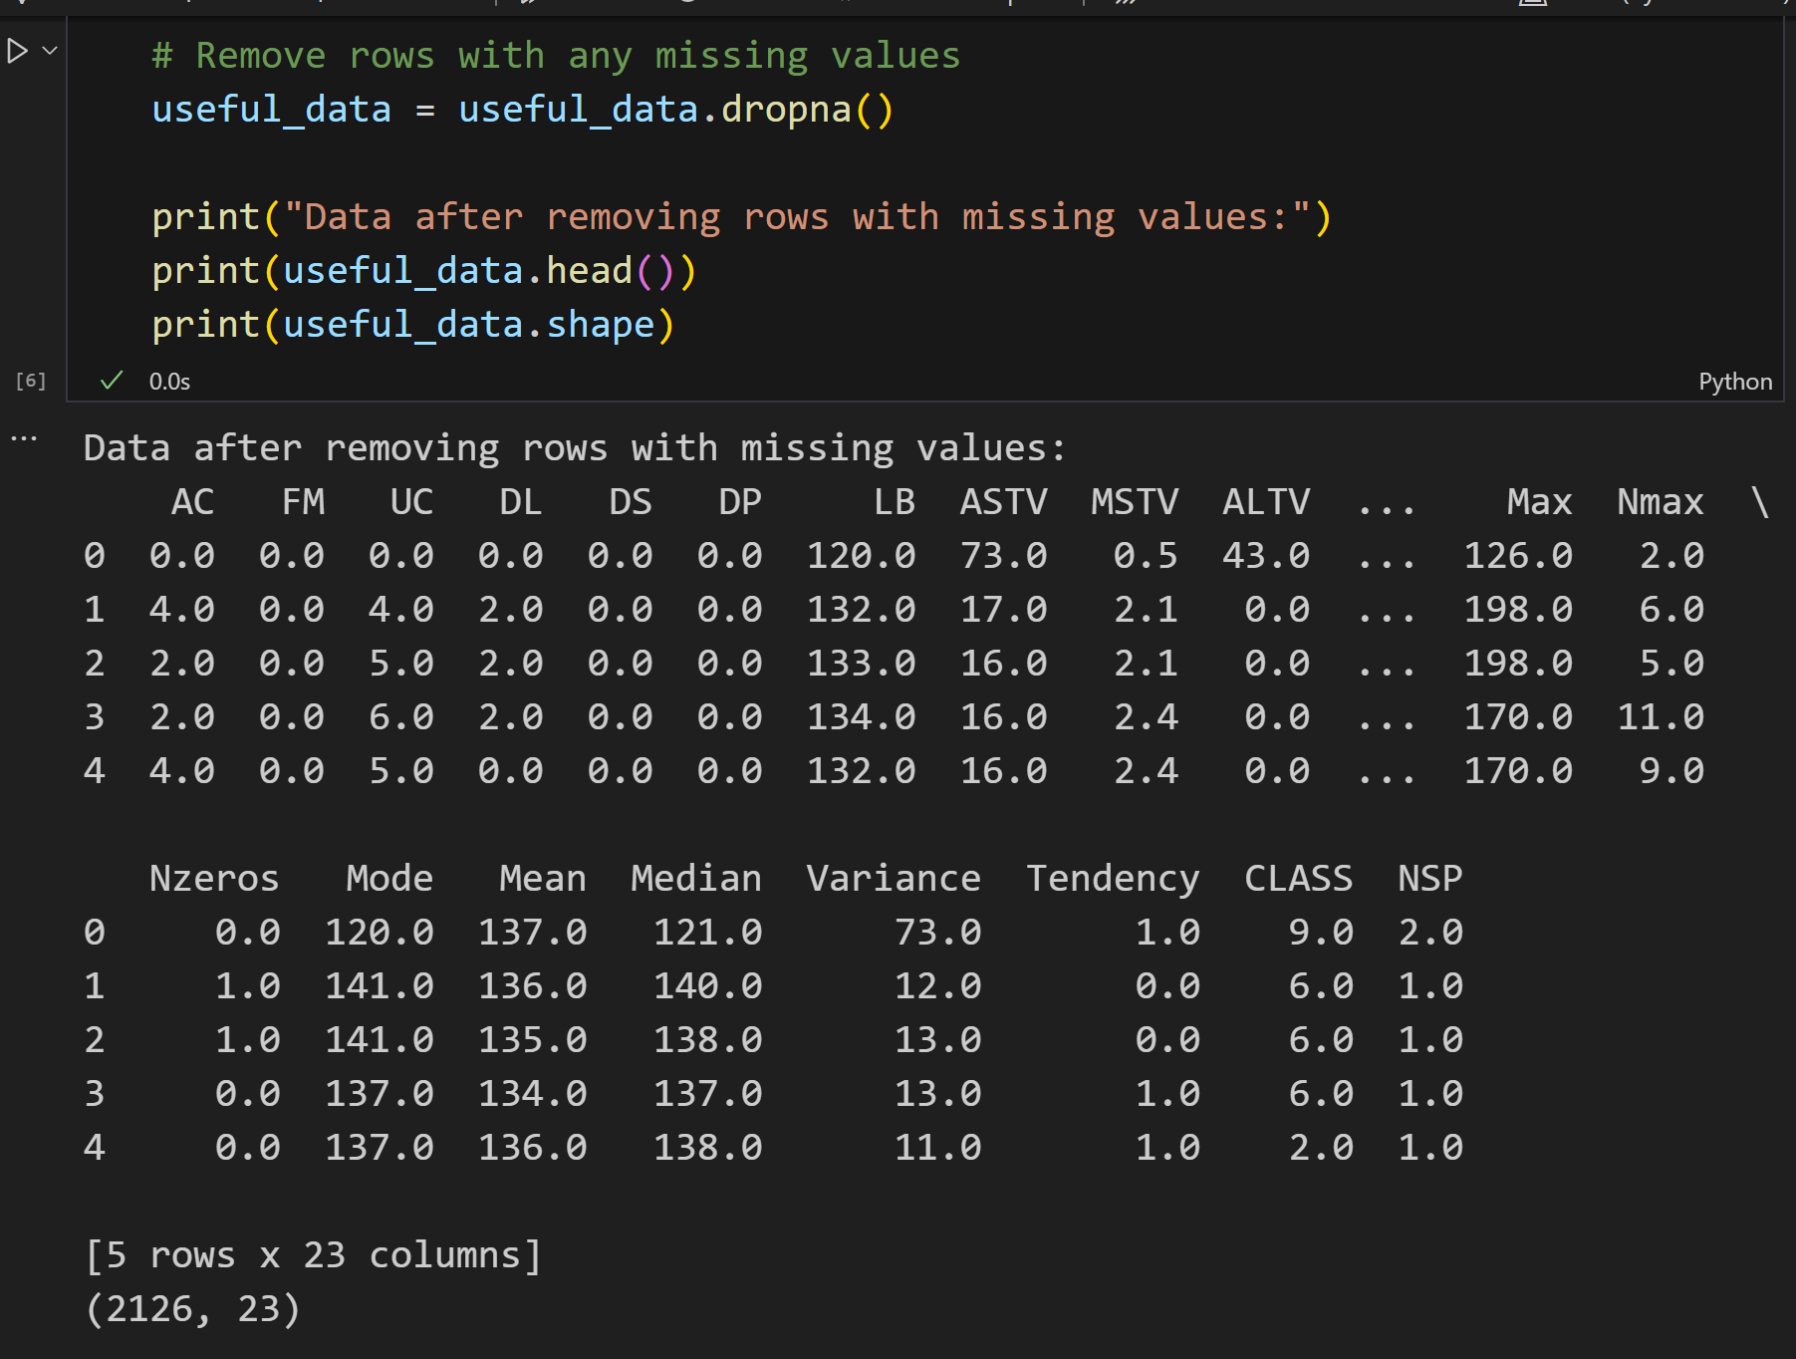
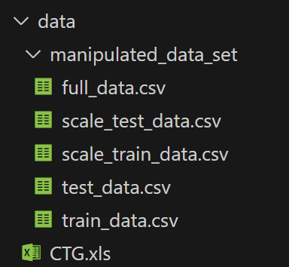
1. Data Clean and Process.
Import and clean
Output data
Scale data
The original dataset is provided in CTG.xls. We first import it as a pandas DataFrame and then export it as CSV for easier processing. We remove empty or invalid values and also create a scaled version for models sensitive to feature scale, such as logistic regression.

Slide 3
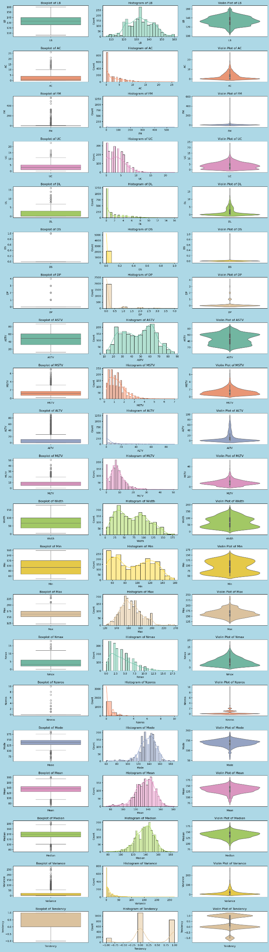
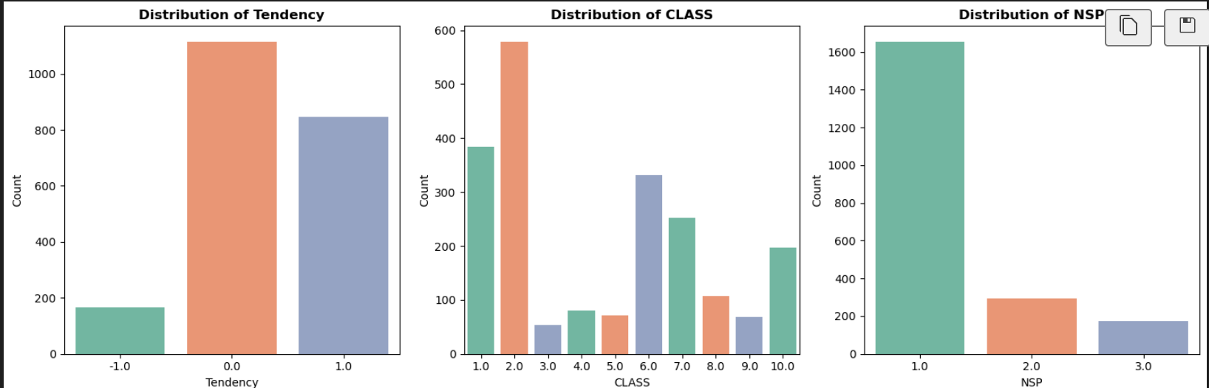
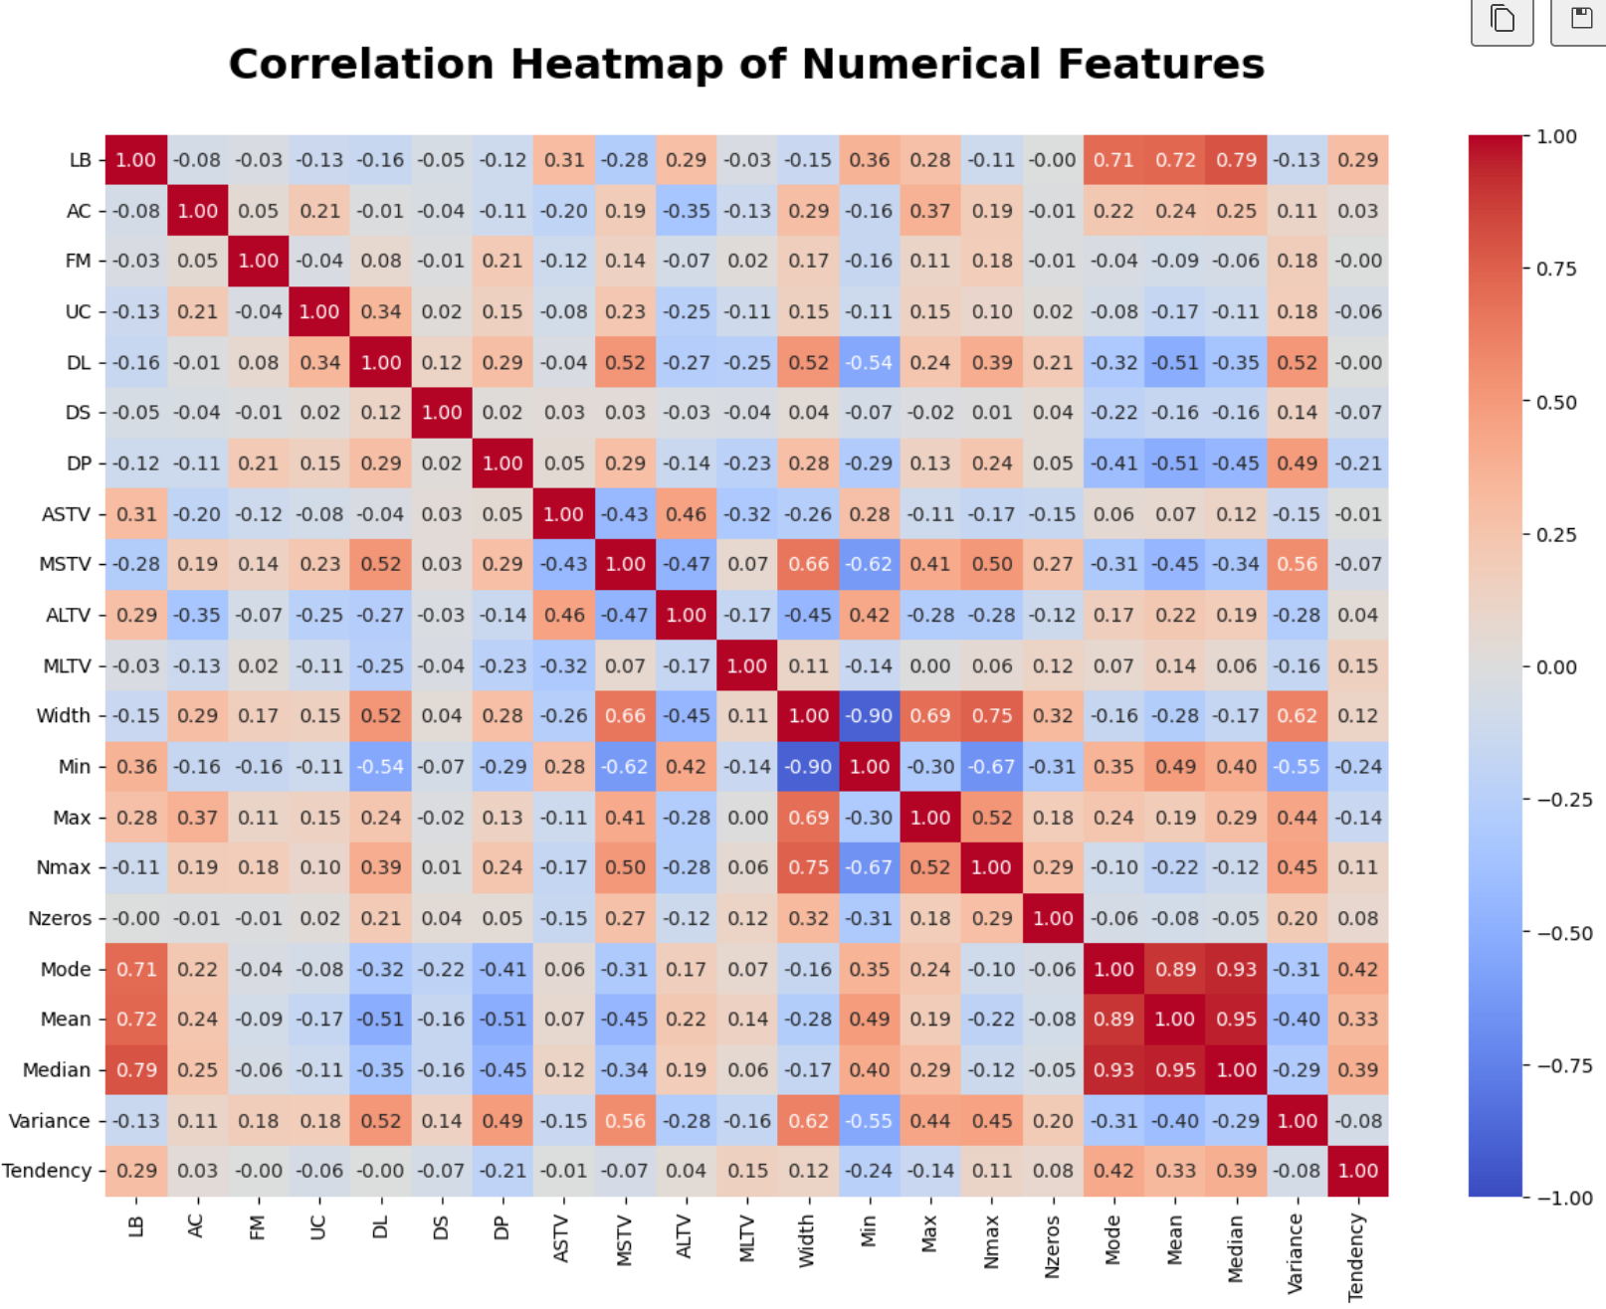
2. Data visualization and explore
To simply approach the data set and see the relations of features first, we do some basic univariate and bi-variate visualization both on class data and numerical data. Include boxplot, histogram, violinplot, correlation heatmap.

Slide 4

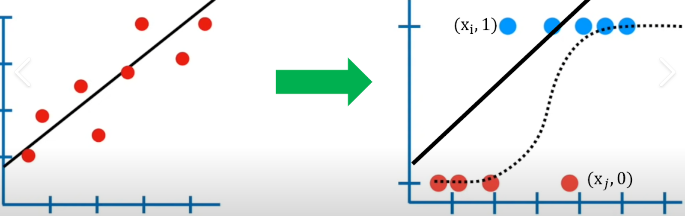
3. Simple approach – Logistic Regression Model
After we have already taken an inside in the relationship, then we can just try a simple Logistic Regression Model.
z=w0​+w1​x1​+w2​x2​+⋯+wn​xn​=wTx+b
p=σ(z)=1/（1+e−z）
Which adapt linear model to fit classification problems.
Here we also use the scale data, because it’s sensitive to data value.
Finally, we reach an accuracy by 89.3%

